Slide 1
Ordination with unifrac distance matrix
With various age, gender subgroups and food tree levels

Slide 2
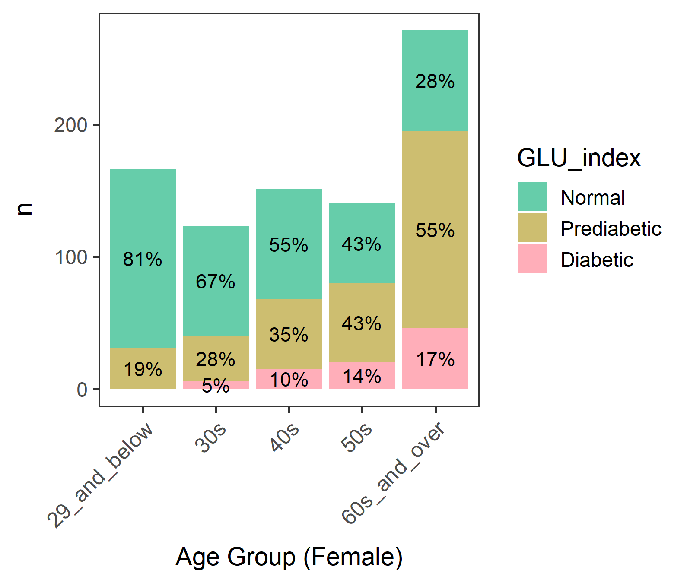
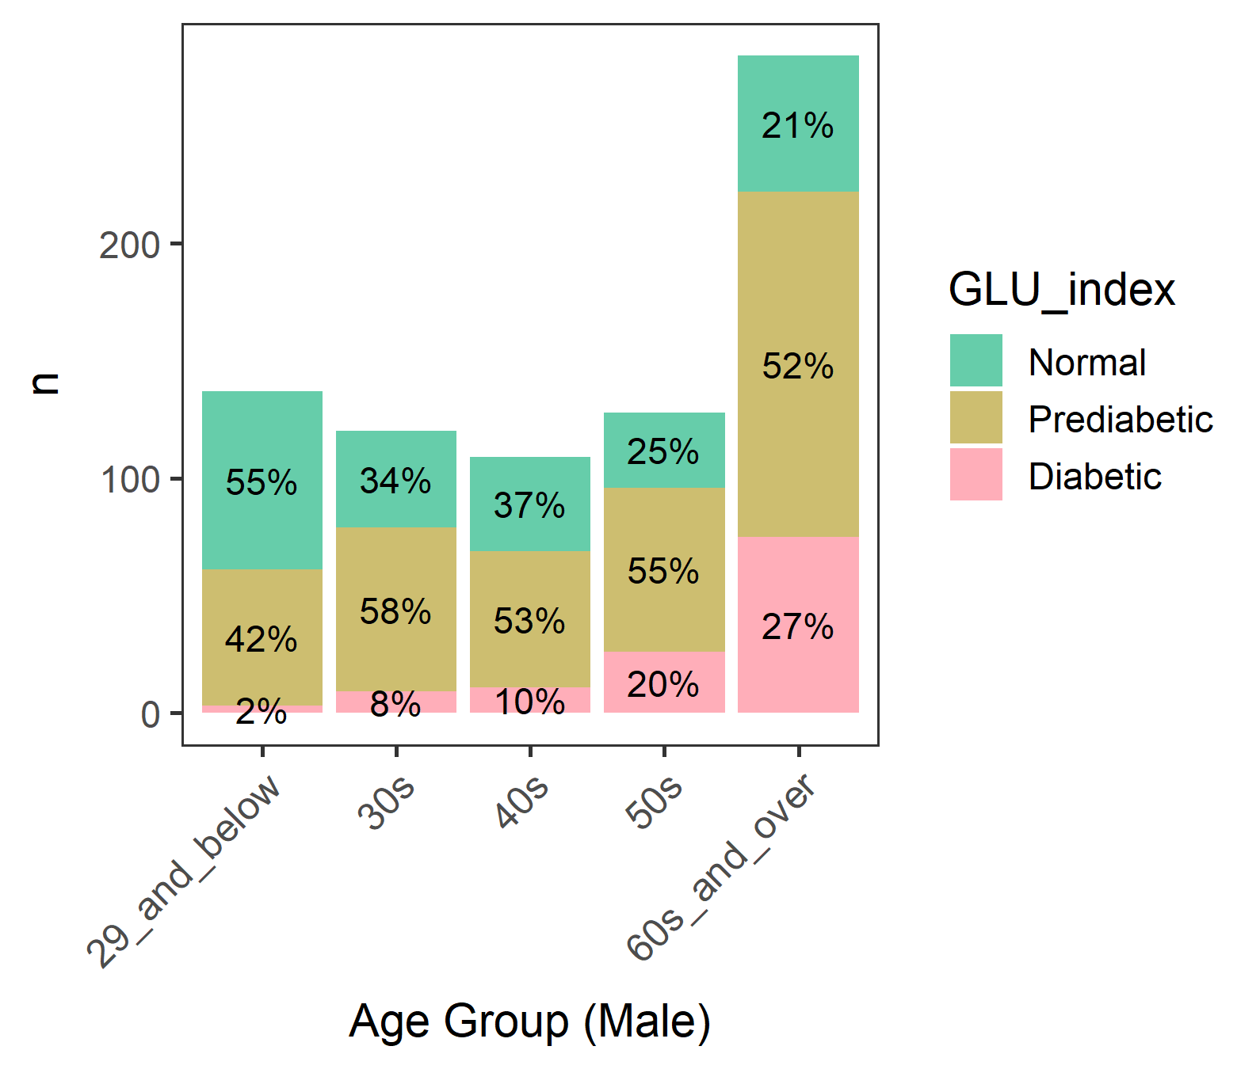
Diabetic groups by gender and age
We focused on male >= 60 where diabetes is most common

Slide 3
Male - Diabetic groups by age
A lot of 80 year-olds. Perhaps 80 or older were grouped.
(Age) 60 61 62 63 64 65 66 67 68 69 70 71 72 73 74 75 76 77 78 79 80
(n) 17 22 14 12 13 17 14 11 8 13 15 11 11 9 12 11 9 7 6 5 43
80+ may not be eating as freely as others due to nursing homes or meal assistance.
But their Normal/Prediabetic/Diabetics percentages are similar to other ages, so should be OK…

Slide 4
Male in 60 and older (60 plus)

Slide 5
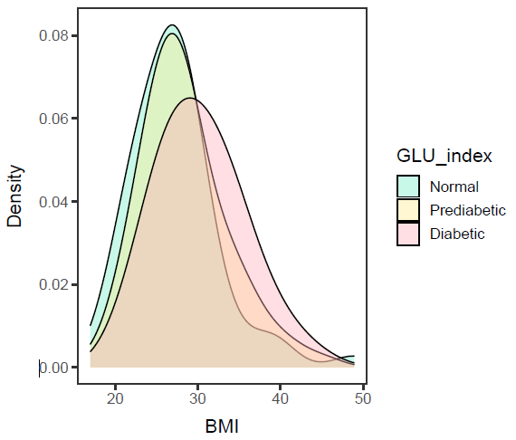
Male in 60 plus, BMI
ANOVA – significant (p-value= 0.0032).
Diabetic is different from Normal and Prediabetic, but
Normal and Prediabetic are not different.
data: df$BMXBMI and df$GLU_index
Normal Prediabetic
Prediabetic 0.1716 -
Diabetic 0.0033 0.0215
Diabetic group has a higher mean BMI than Prediabetic and Normal group.

Slide 6
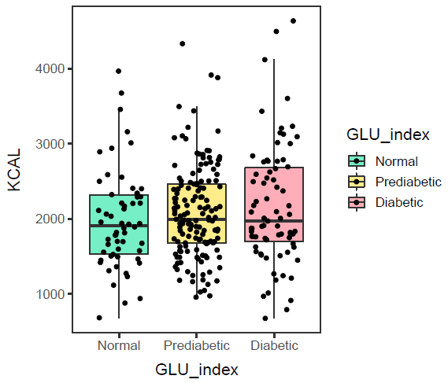
Male in 60 plus, KCAL
ANOVA – not significant (p-value=0.308).
Hmm, so no need to control KCAL intake.
Calorie intake of Normal, Prediabetic, and Diabetic groups are not different.

Slide 7
Ordination with unifrac distance matrices

Slide 8
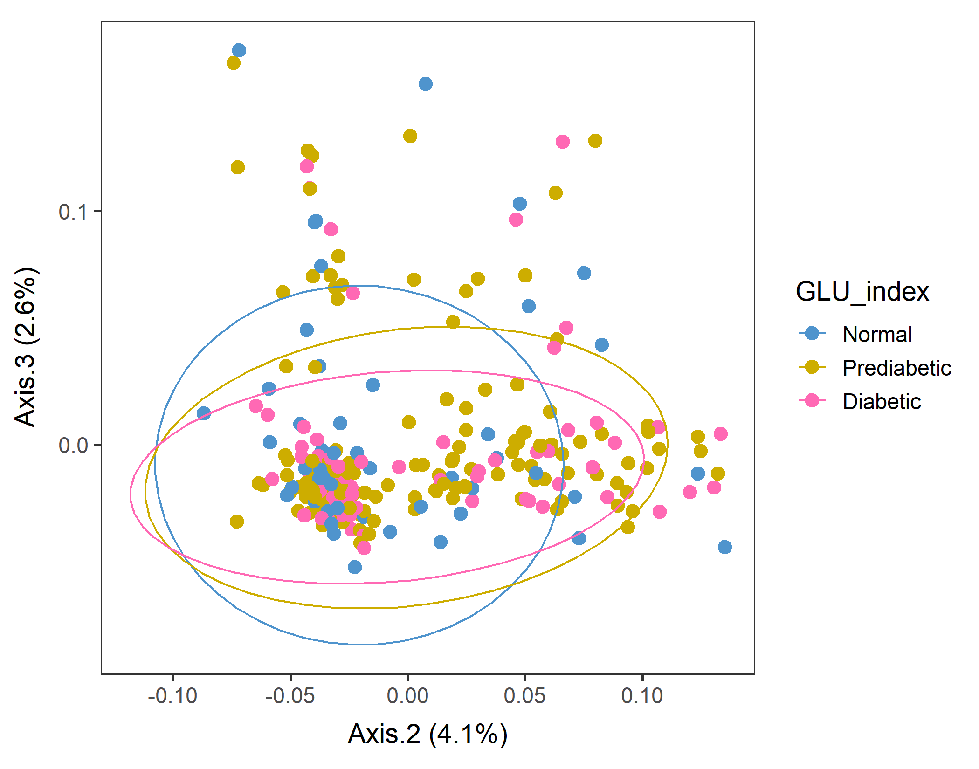
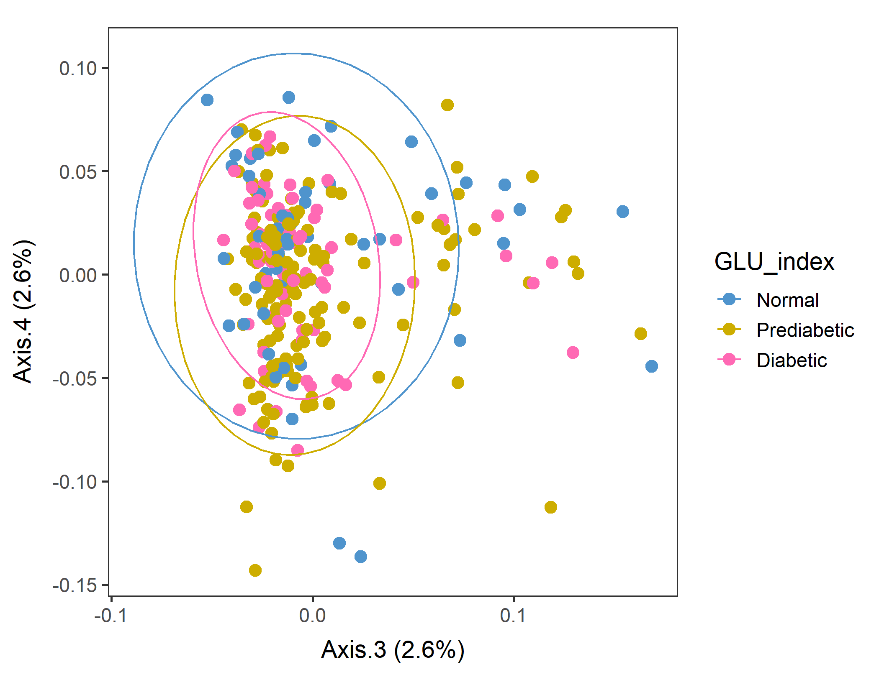
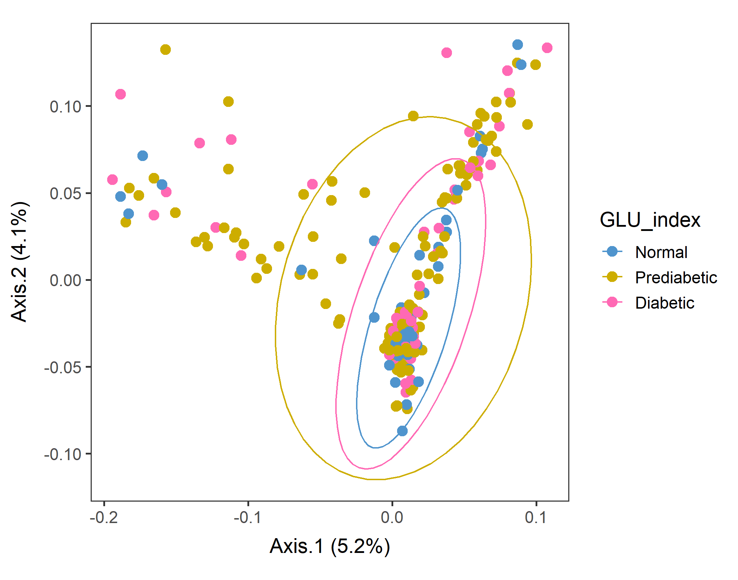
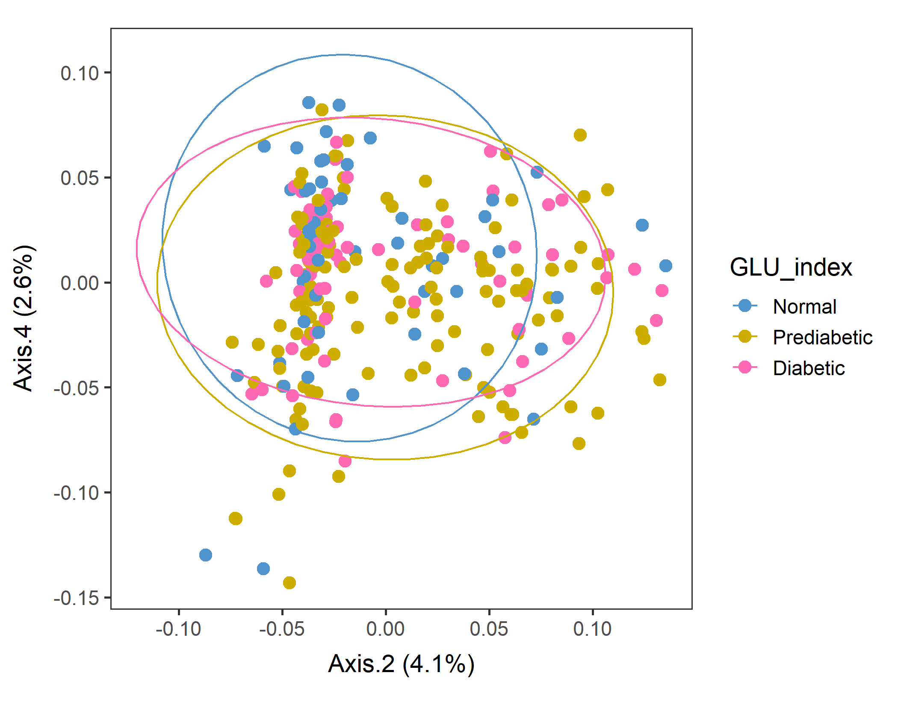
Male in 60plus Lv2 WEIGHTED
In Axes 2&3 and Axes2&4, Normal subpopulations look distinct.
Conversion failed
vegan::permutest: p-value ~0.15. Assumption OK.
vegan::adonis: p-value 0.04. Groups are different.
But pairwise.adonis not significant for any pair.

Slide 9
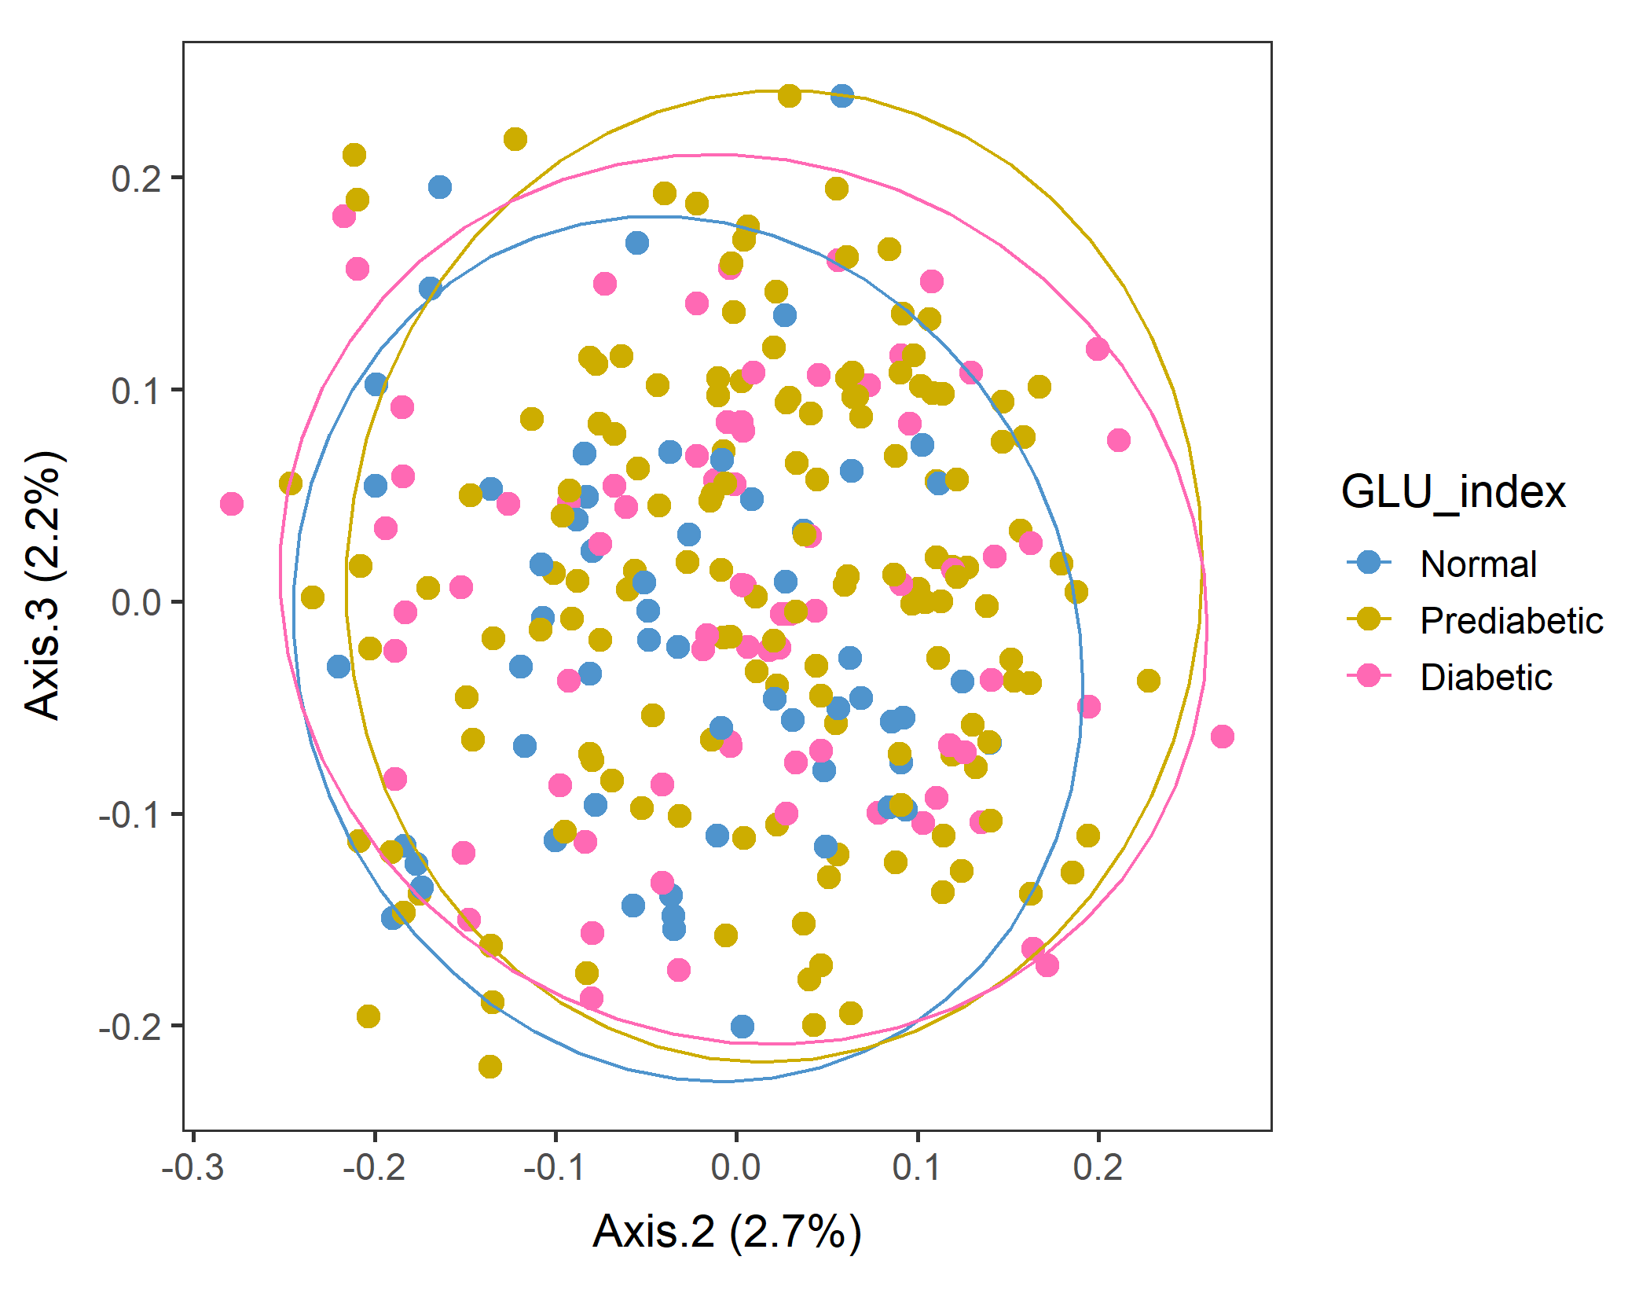
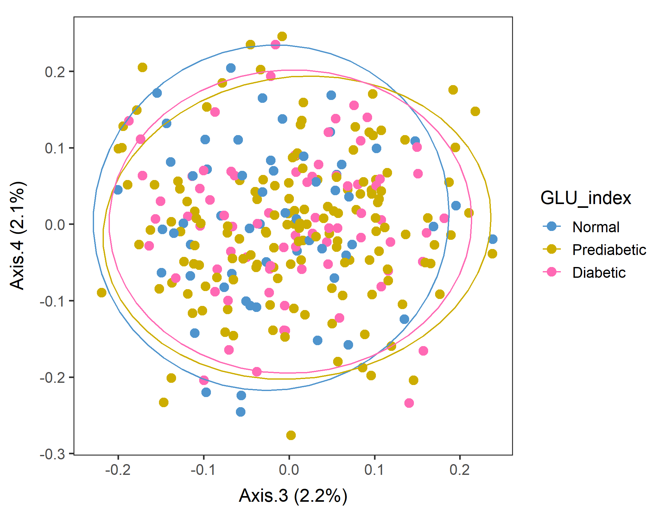
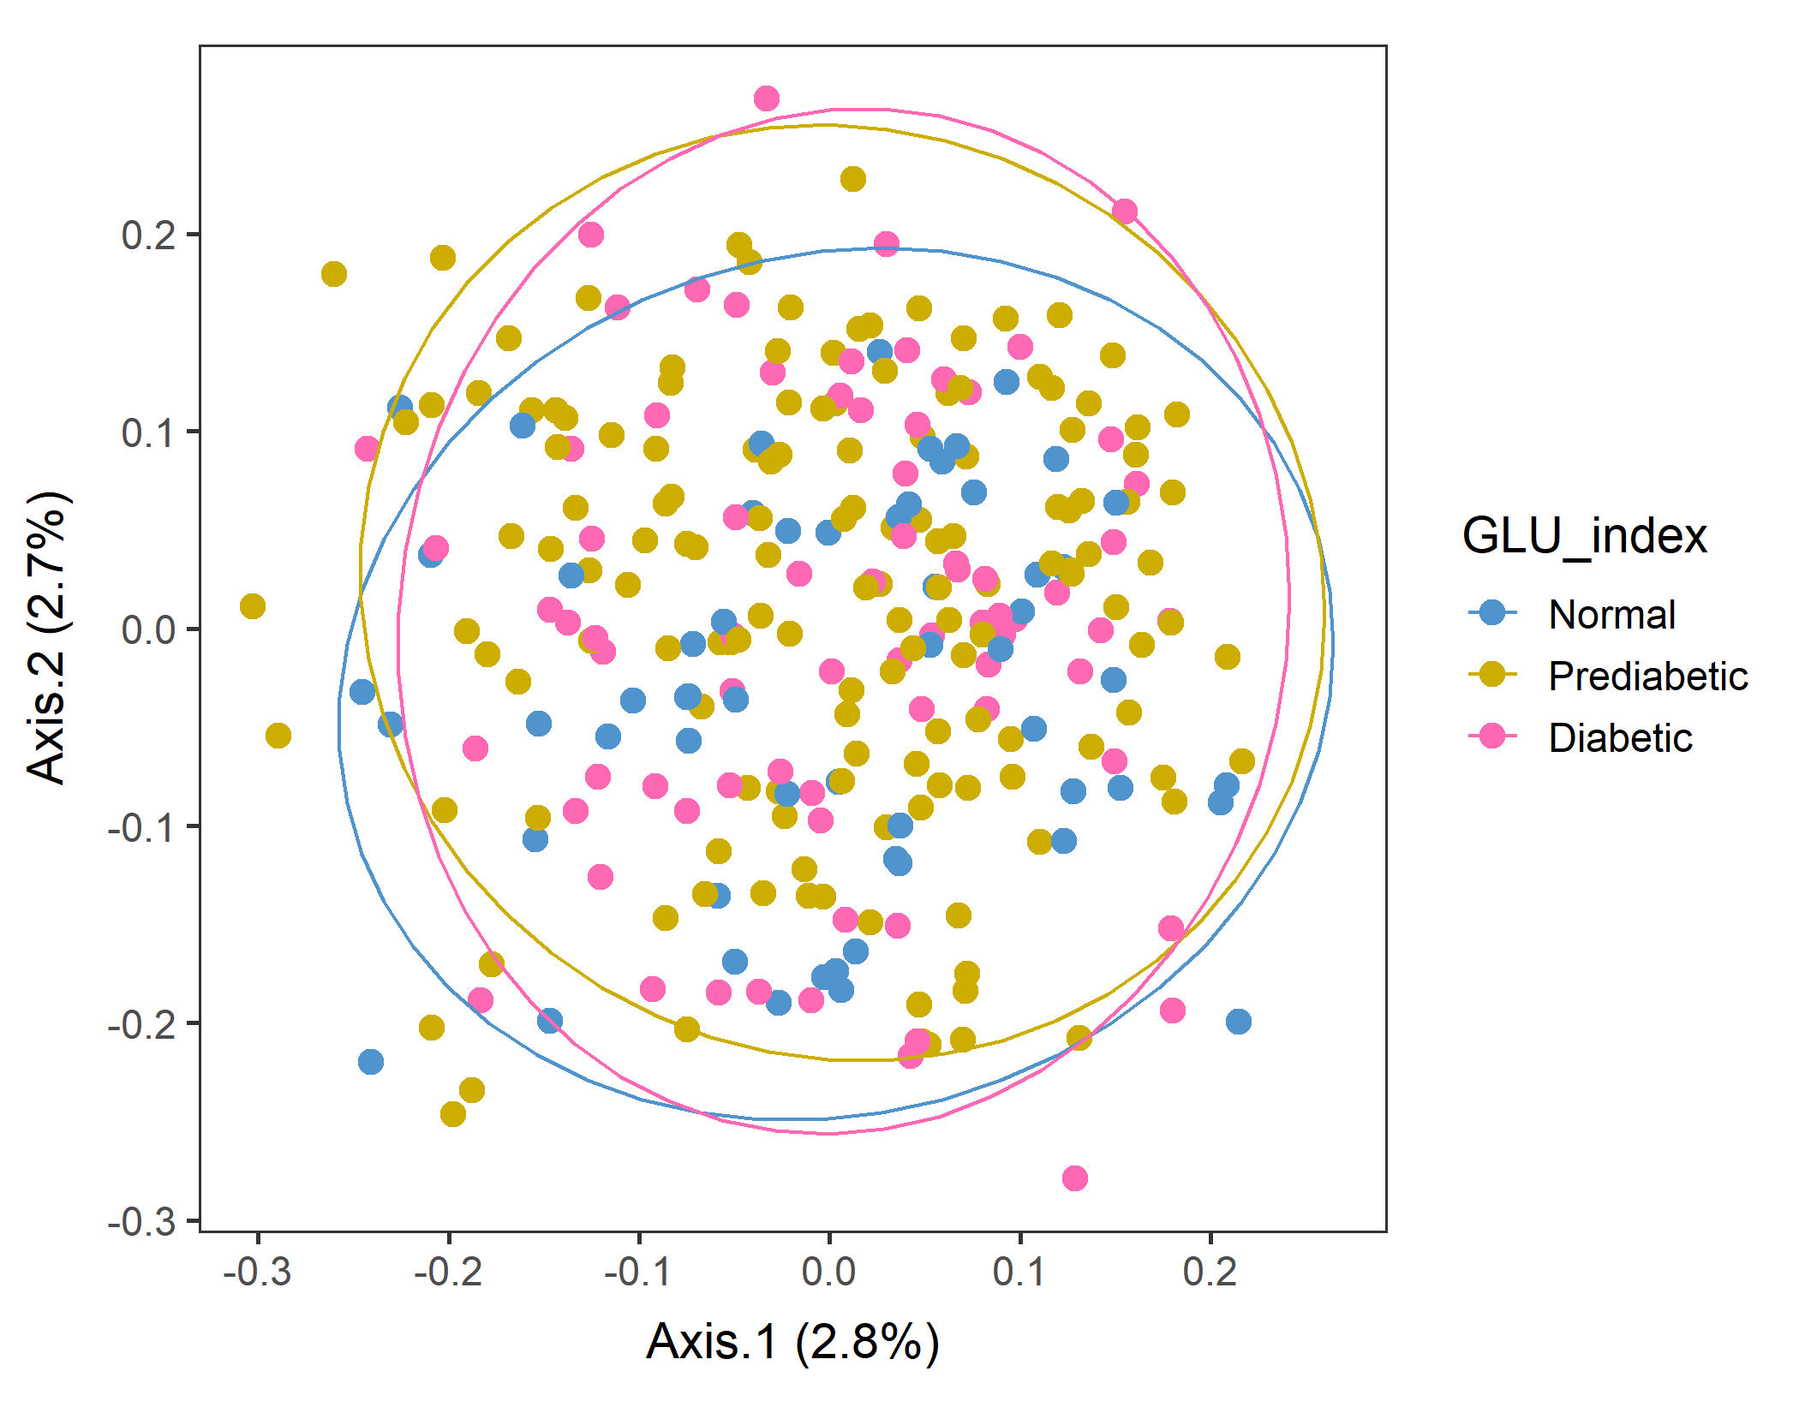
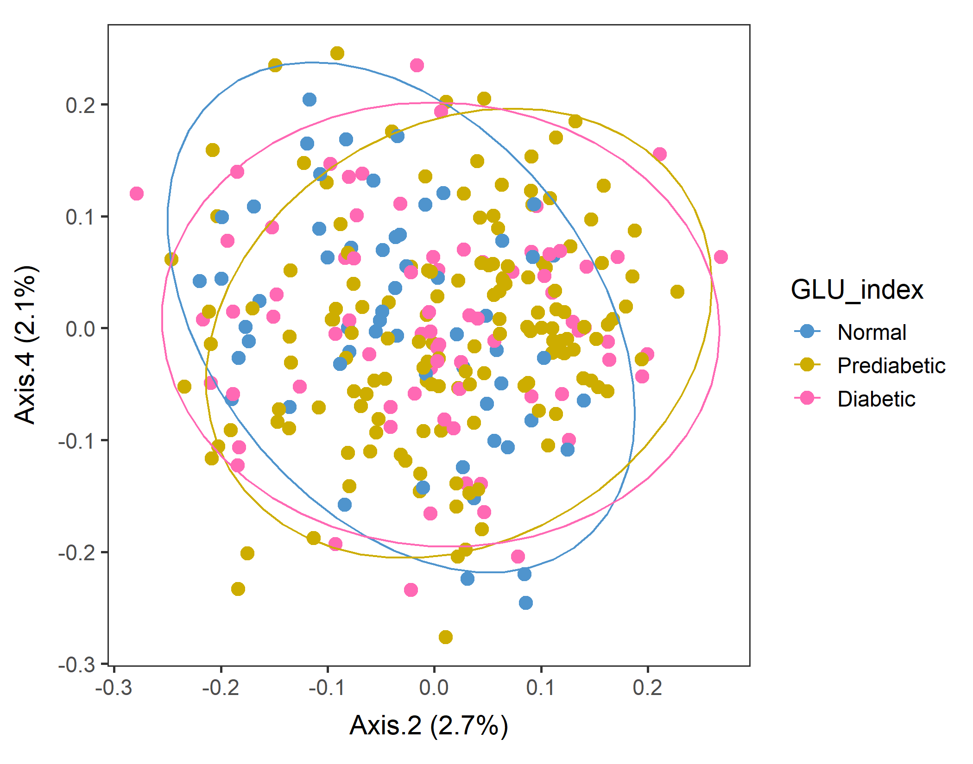
Male in 60plus Lv2 UNweighted
Axes 1&2
vegan::permutest: p-value ~0.8. Assumption OK.
vegan::adonis: p-value:0.013. Groups are different.
But pairwise.adonis not significant for any pair.

Slide 10
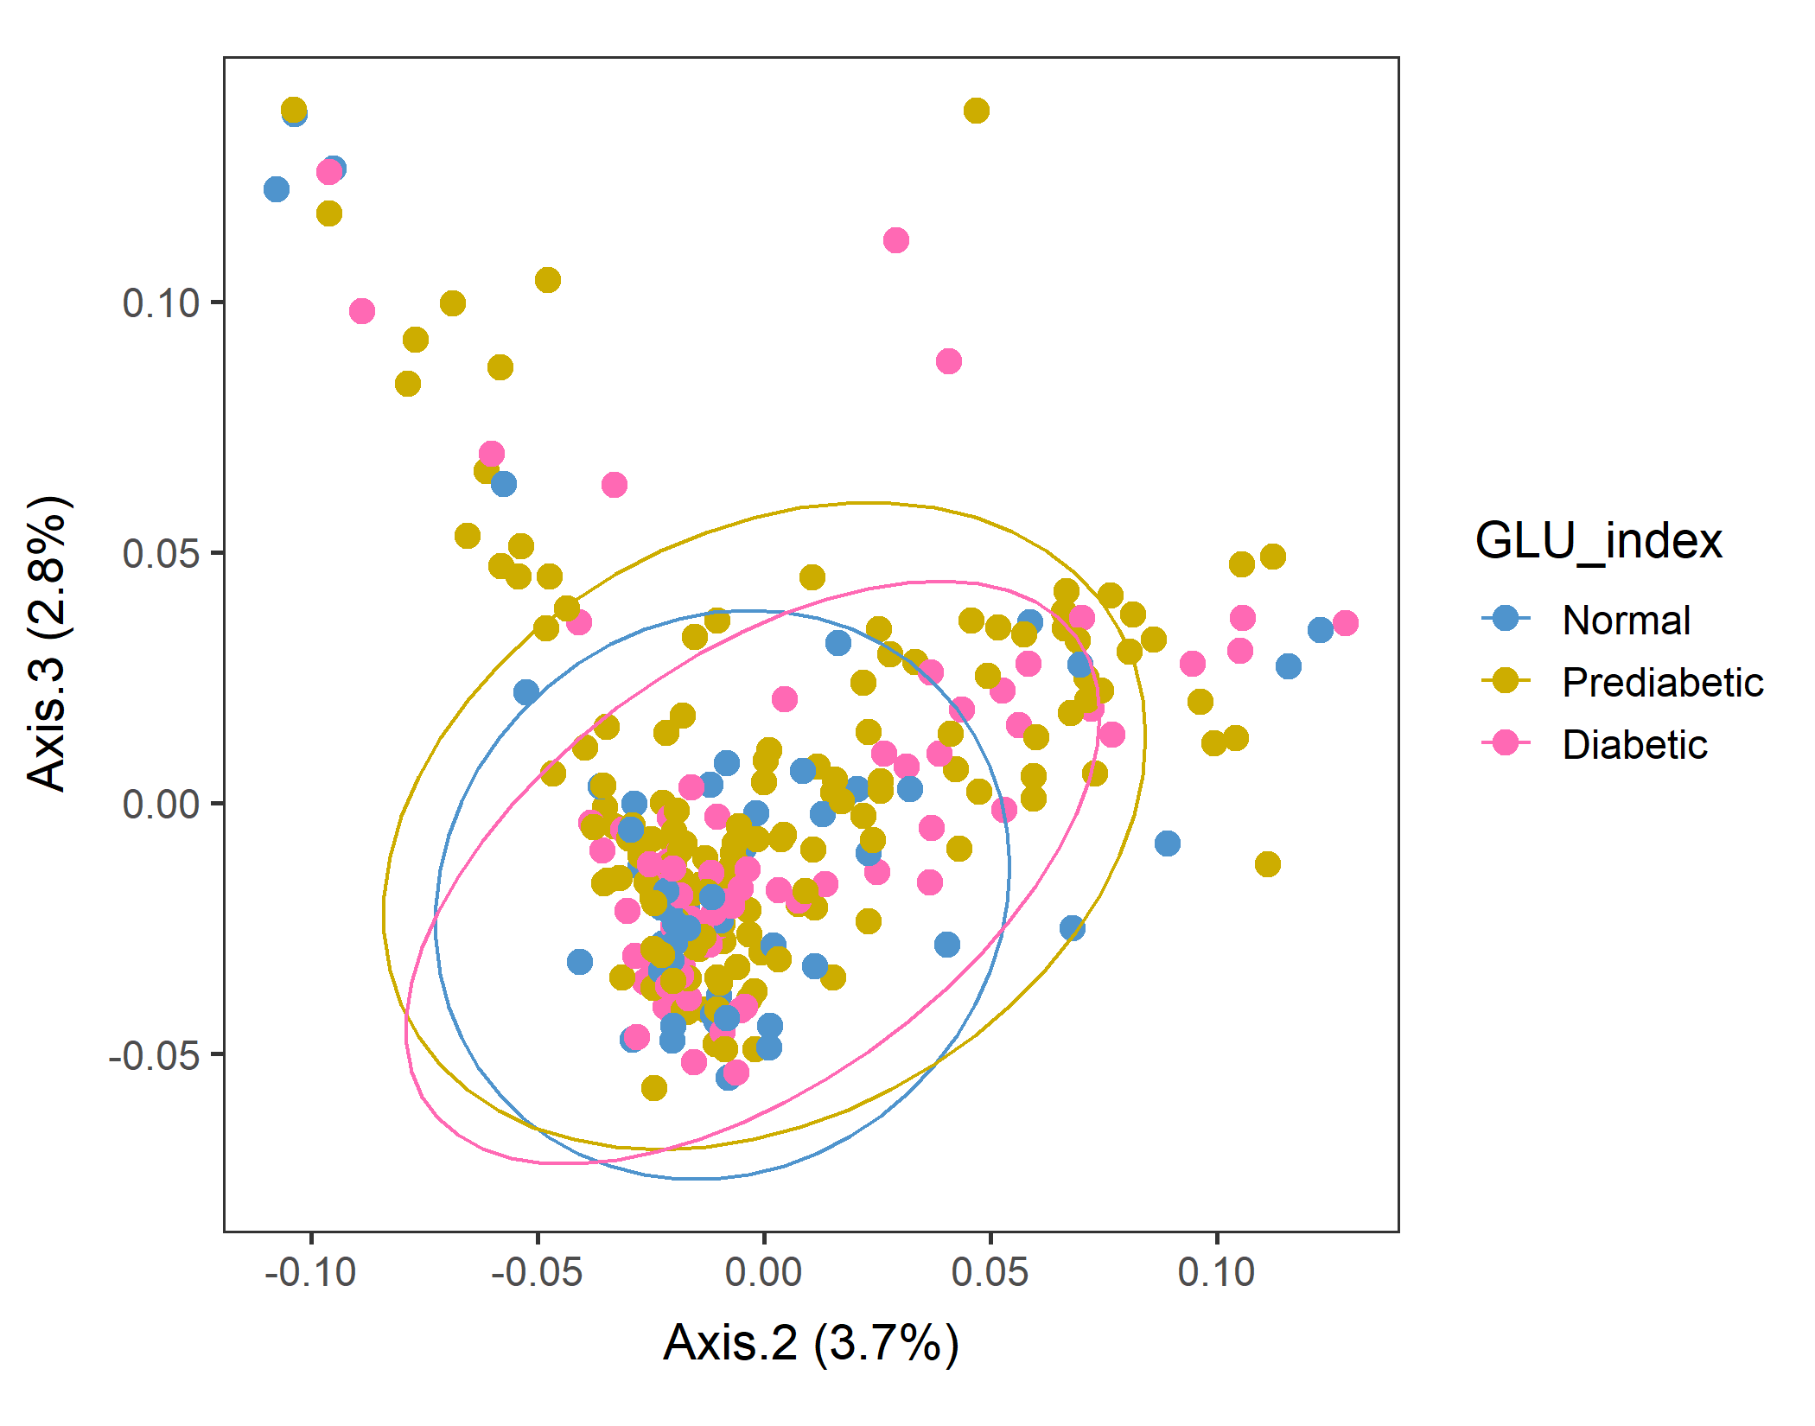
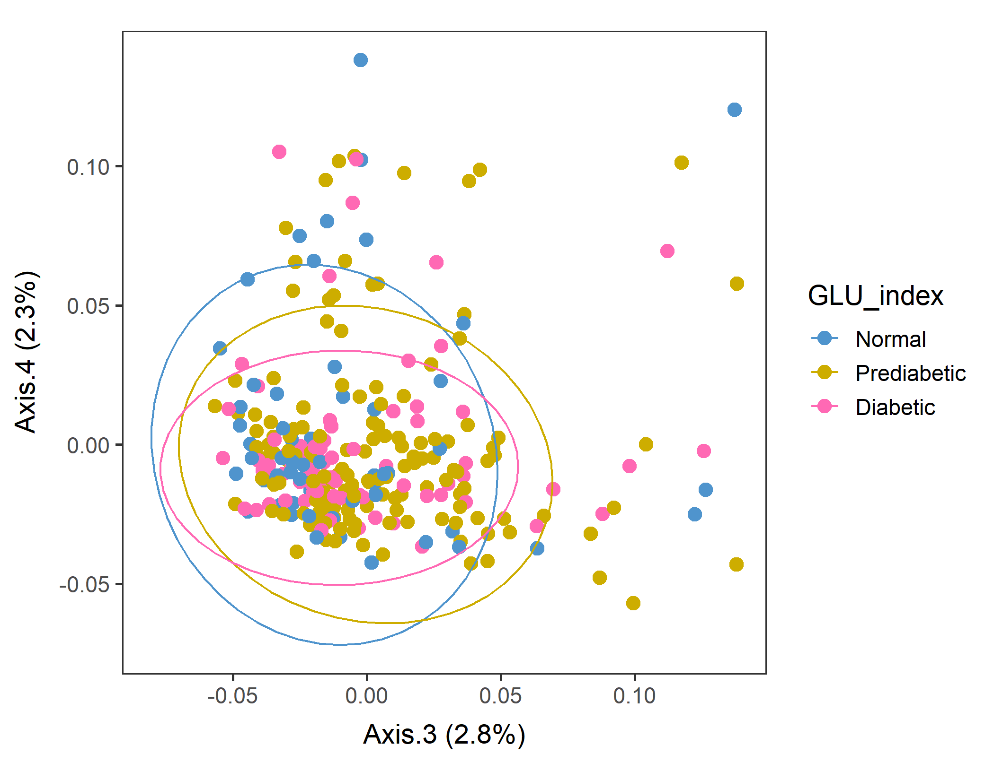
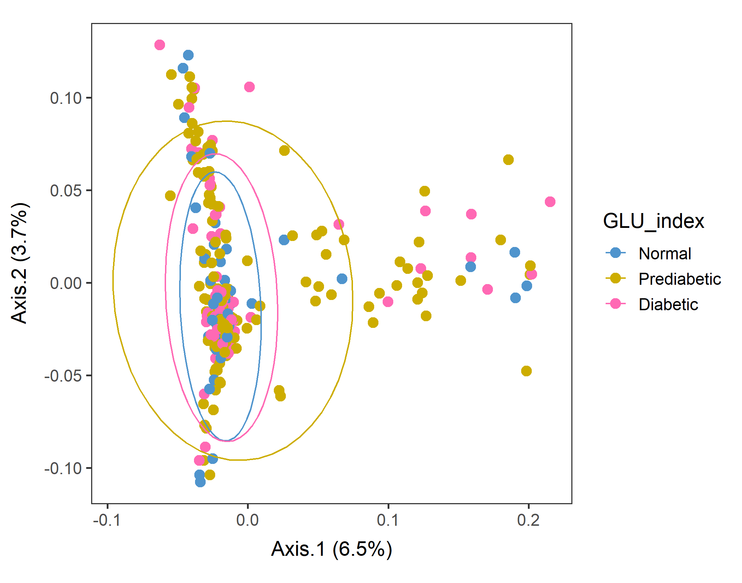
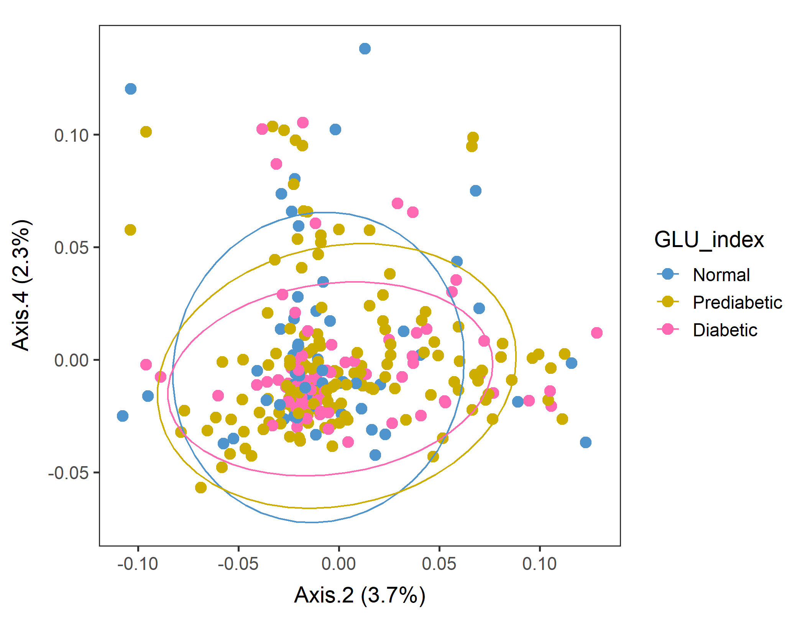
Male in 60plus Lv3 WEIGHTED
Conversion failed
vegan::permutest: p-value ~0.18. Assumption OK.
vegan::adonis: p-value 0.06. Groups are borderline but not different.
Not supposed to do this, but run pairwise adonis (with correct the sample order!). Prediabetic vs Normal are different (p=0.034) but other pairs are not.

Slide 11
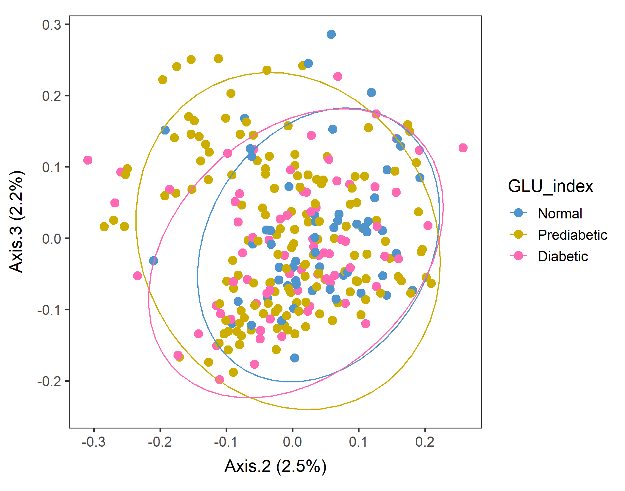
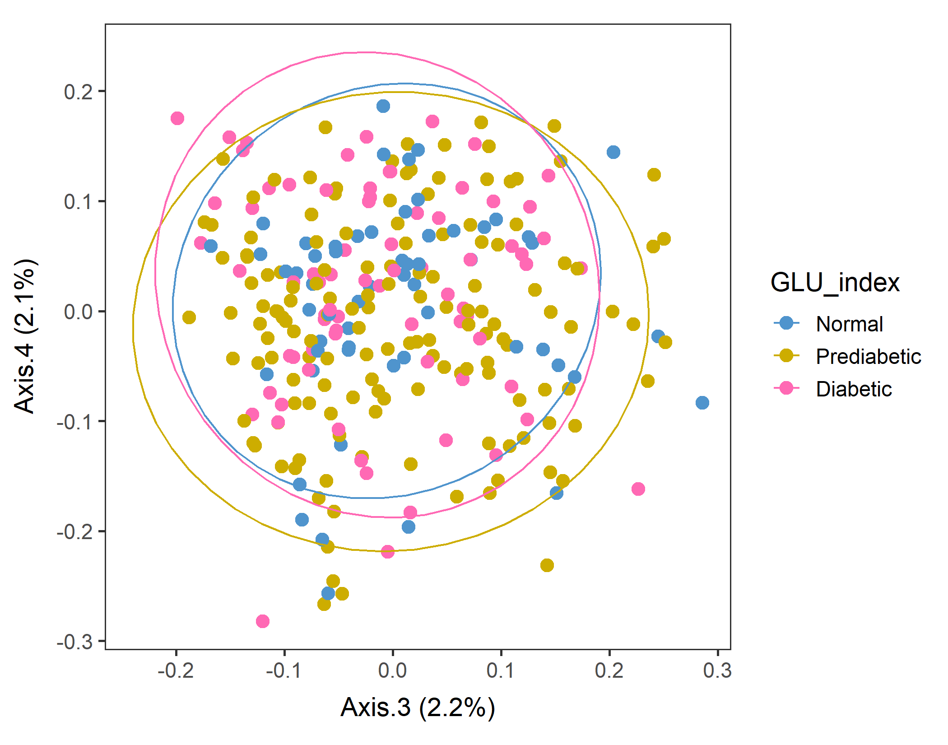
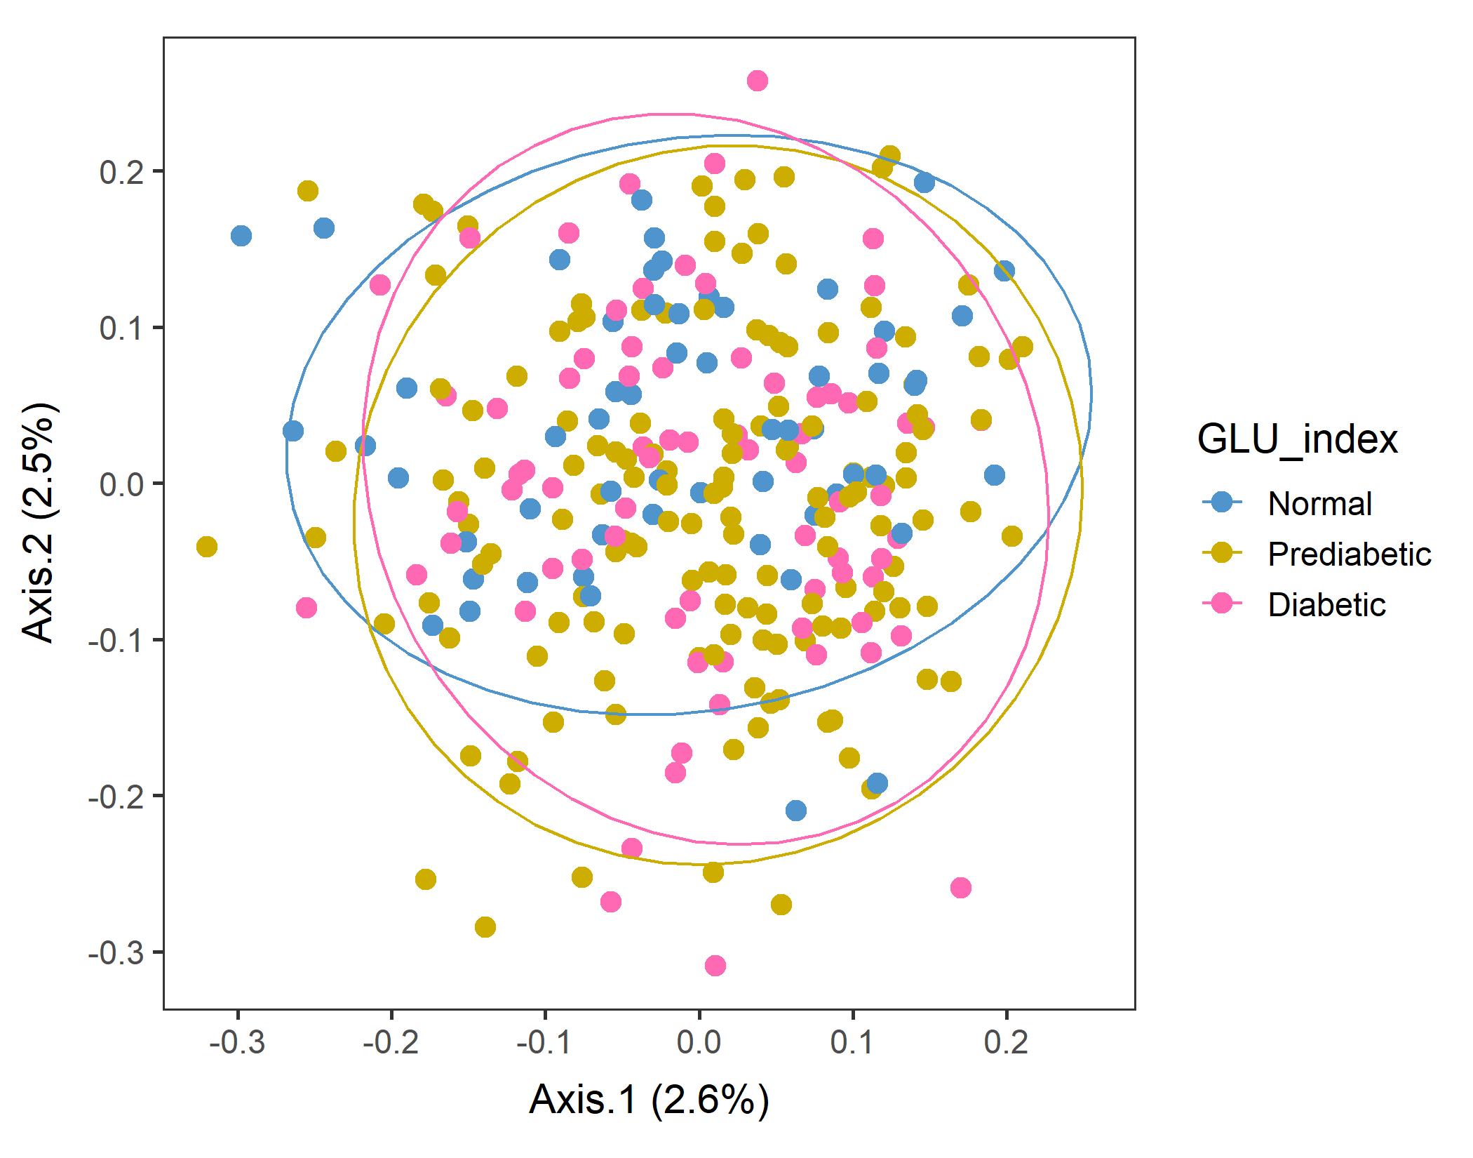
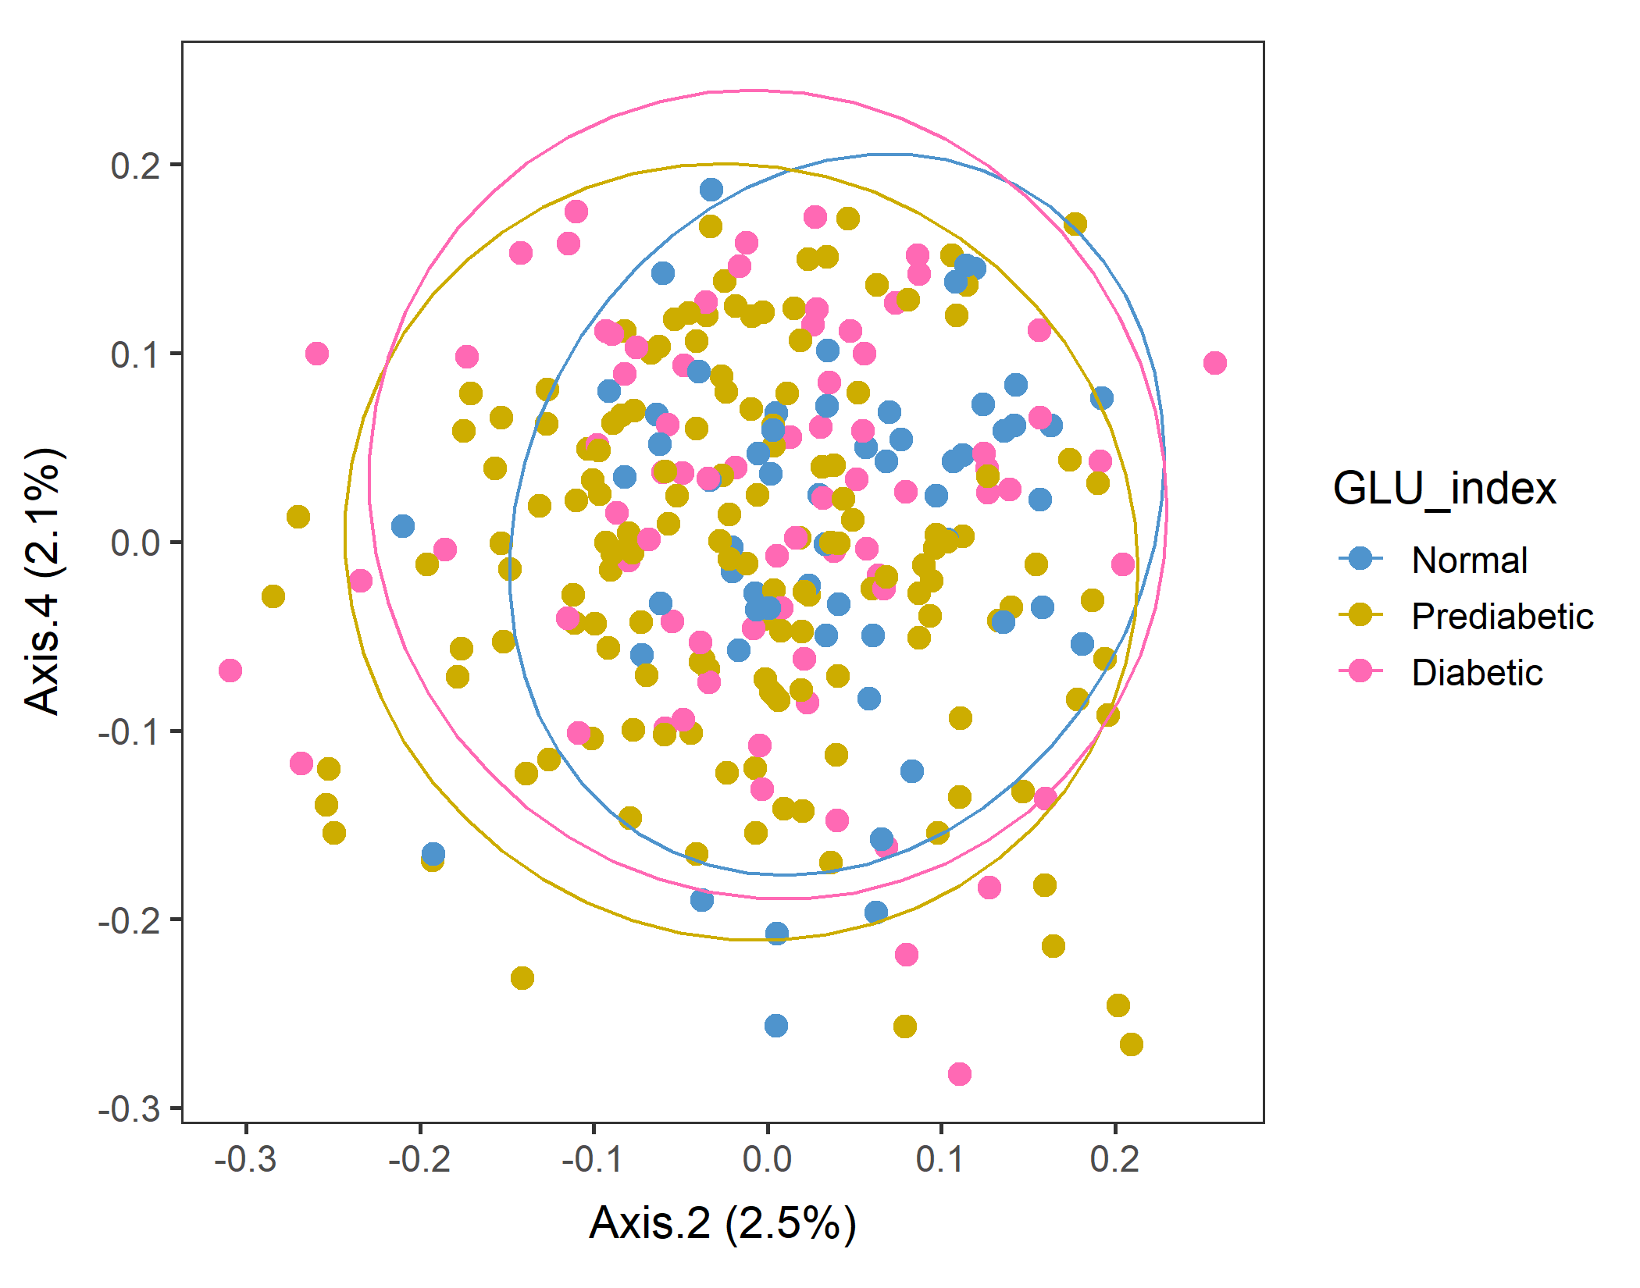
Male in 60plus Lv3 UNweighted
Axes 1&2
vegan::permutest: p-value ~0.86. Assumption OK.
vegan::adonis: p-value:0.007. Groups are different.
Run pairwise adonis (with correct the sample order!). Prediabetic vs Normal are different (p=0.006) but other pairs are not.

Slide 12
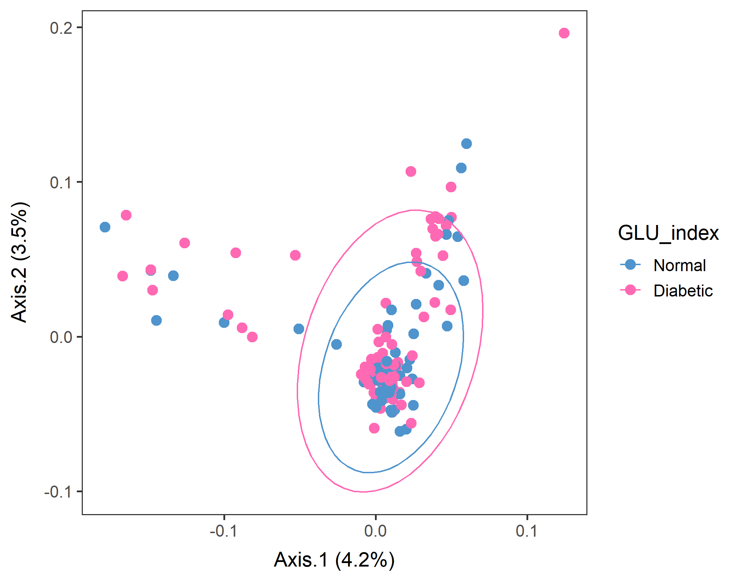
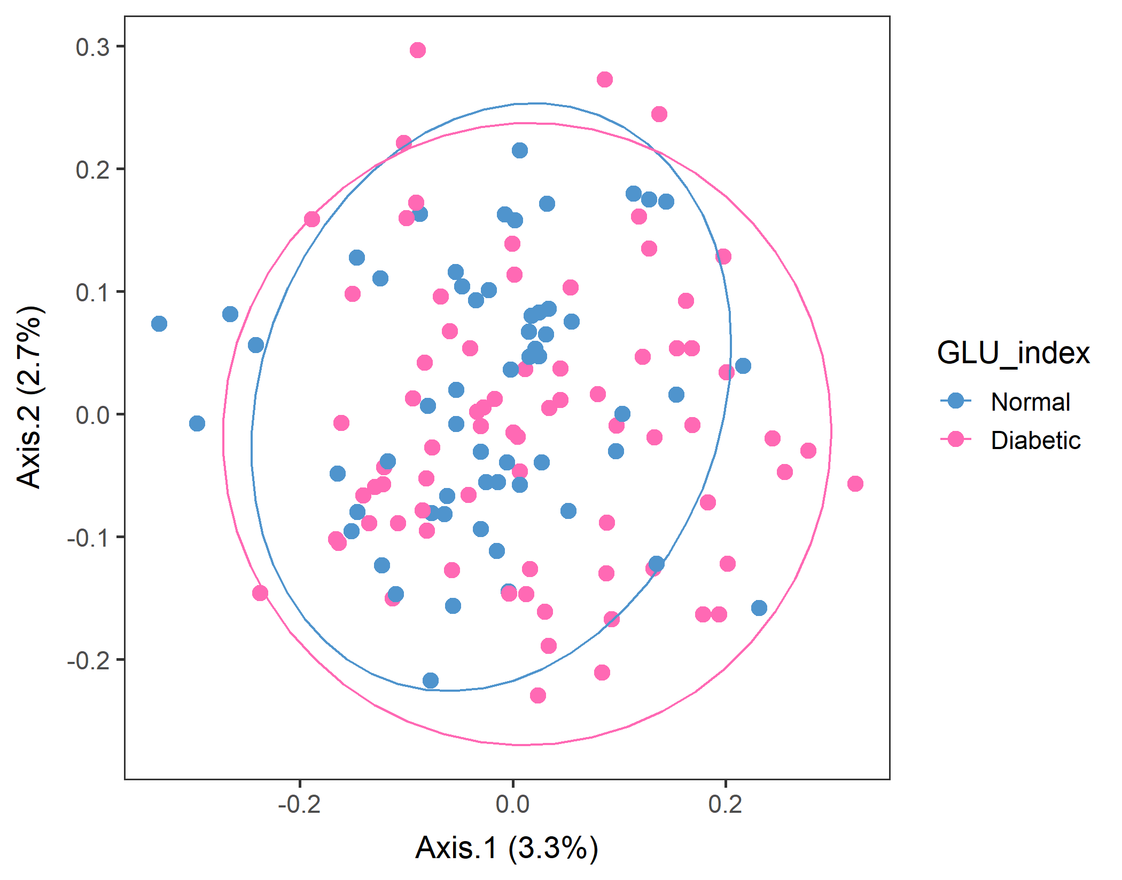
If you subset only Normal and Diabetic, is there a difference between them?
WEIGHTED
vegan::permutest: p-value ~0.15. Assumption OK.
vegan::adonis: p-value: 0.06. Groups are still borderline..
Pairwise adonis should return the same results as overall adonis because there are only two groups. And it did with a similar p-value.
UNweighted
vegan::permutest: p-value ~0.6. Assumption OK.
vegan::adonis: p-value:0.04. Groups are different..
Pairwise adonis should return the same results as overall adonis because there are only two groups. And it did with a similar p-value.
Should look at Normal vs. Prediabetic.

Slide 13
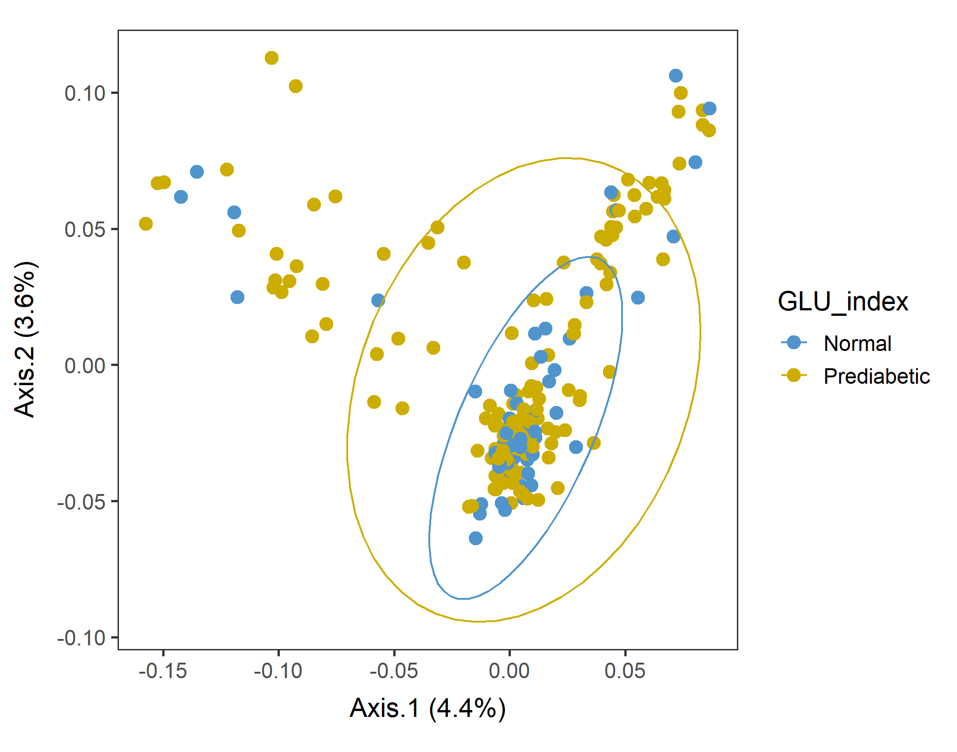
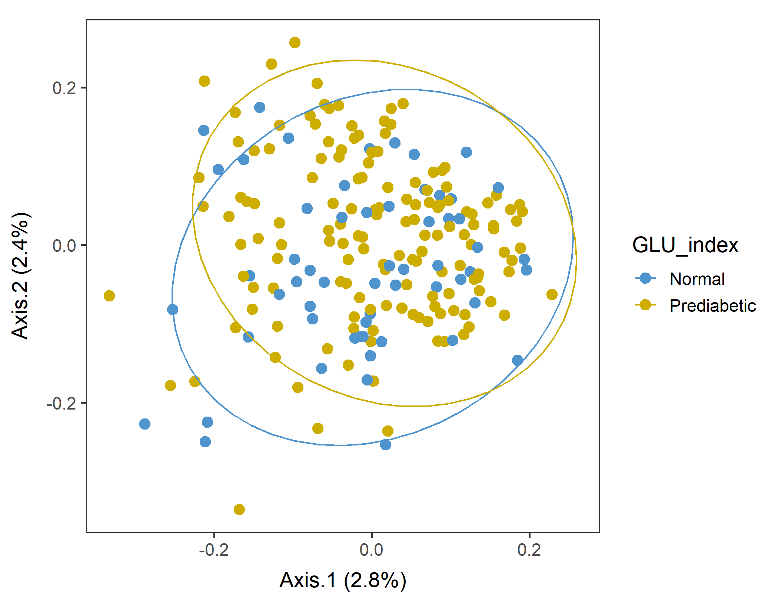
If you subset only Normal and Prediabetic, is there a difference between them?
WEIGHTED
vegan::permutest: p-value ~0.5. Assumption OK.
vegan::adonis: p-value: 0.02. Groups are different, as expected.
Pairwise adonis should return the same results as overall adonis because there are only two groups. And it did with a similar p-value.
UNweighted
vegan::permutest: p-value ~0.77. Assumption OK.
vegan::adonis: p-value: ~0.01. Groups are different.
Pairwise adonis should return the same results as overall adonis because there are only two groups. And it did with a similar p-value.
Yes, they are different!

Slide 14
Ordination with an Euclidean distance matrix
.

Slide 15
Male in 60plus test separation using adonis by feeding Euclidean distance matrix to the model.
dist_matrix_e <- dist(as.data.frame(t(food2)), method = "euclidean", diag = T)
vegan::adonis(DISTANCE_MATRIX, FACTOR, perm=999)
In theory, it can handle any distance matrix, even Euclidean.
vegan::permutest: p-value ~0.9. Assumption OK.
vegan::adonis: p-value”: 0.08. Groups are not different.
Pairwise.adonis: All pairs are not different (p ~0.14).

Slide 16
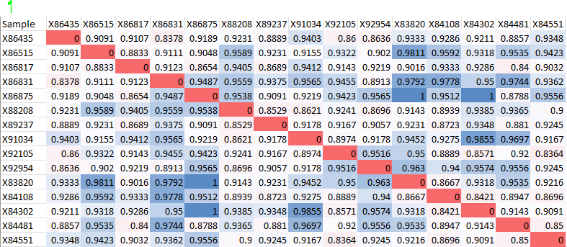
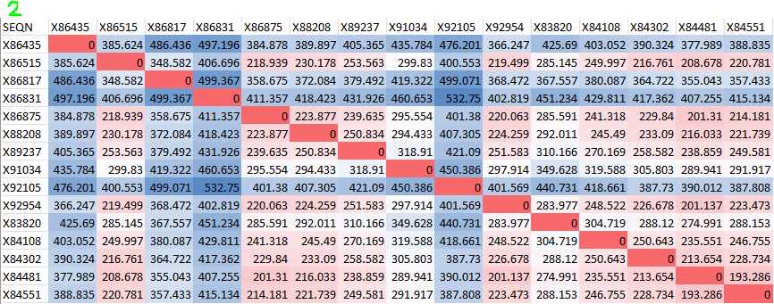
Male in 60plus test separation using adonis by feeding Euclidean distance matrix to the model.
Comparison of Unweighted unifrac distance matrix (1) and Euclidean distance matrix (2).
These two don’t look similar…?!

Slide 17
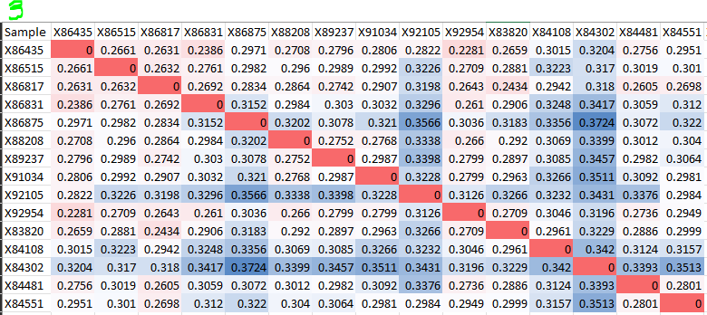
Male in 60plus PCA test separation using adonis by feeding Euclidean distance matrix to the model.
Comparison of Euclidean distance matrix (2) and WEIGHTED unifrac distance matrix (3).
Weighted looks closer to Euclidean, unexpectedly.

Slide 18
What to do next…
So far, the only subset that showed between-group difference was
Male in 60plus Lv3 tree with Unweighted unifrac distance.
So… use this subpopulation for now to see the correlation between food variable and PCoA Axis.

Slide 19
Correlation between Axis values and variables (foods)
.

Slide 20
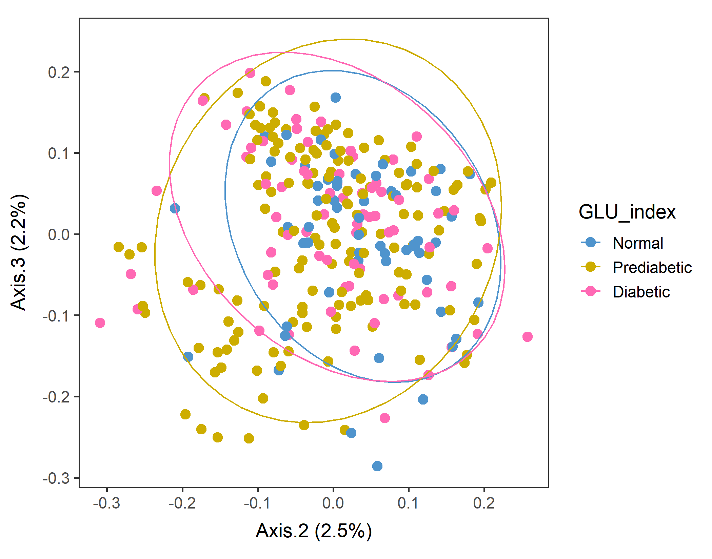
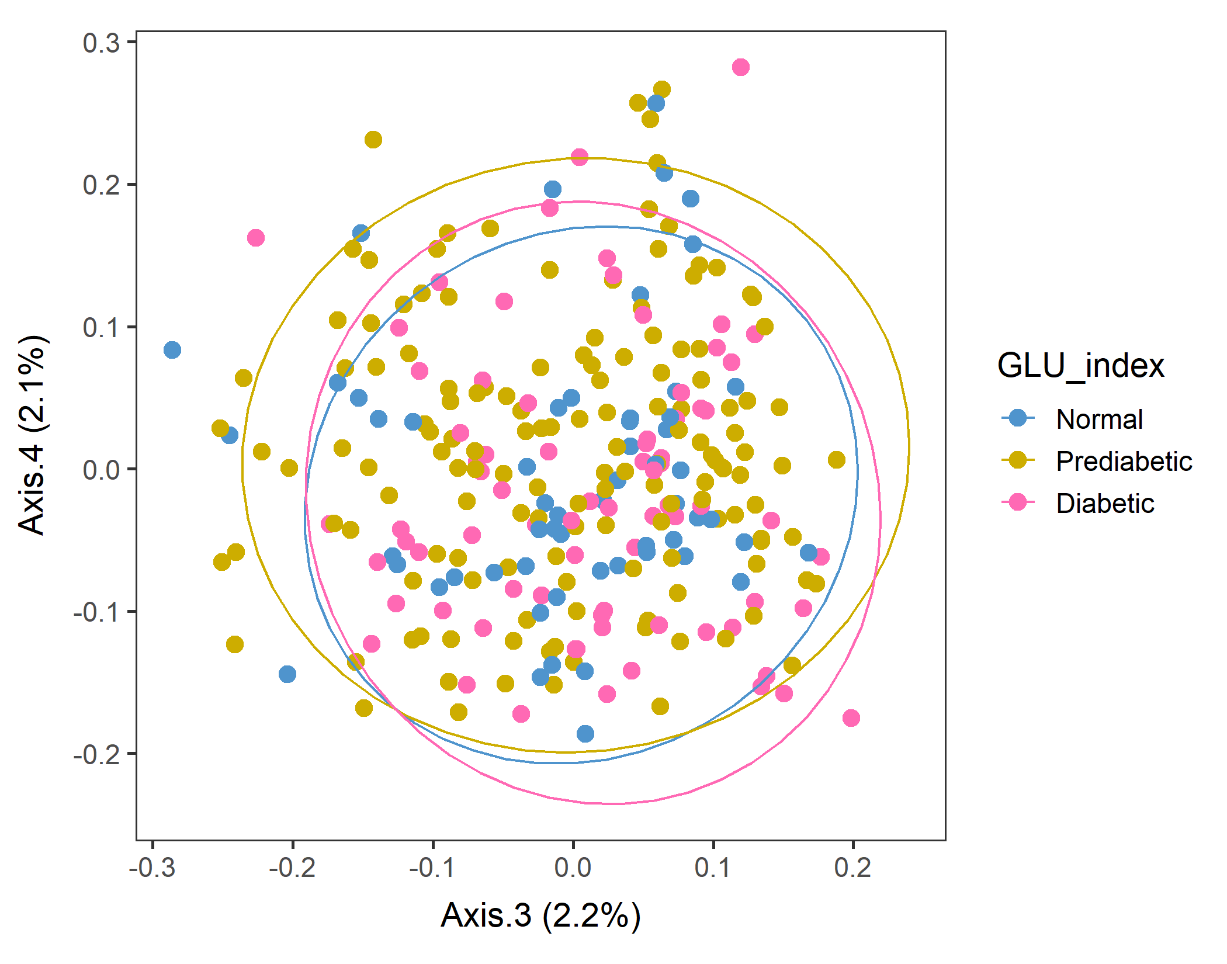
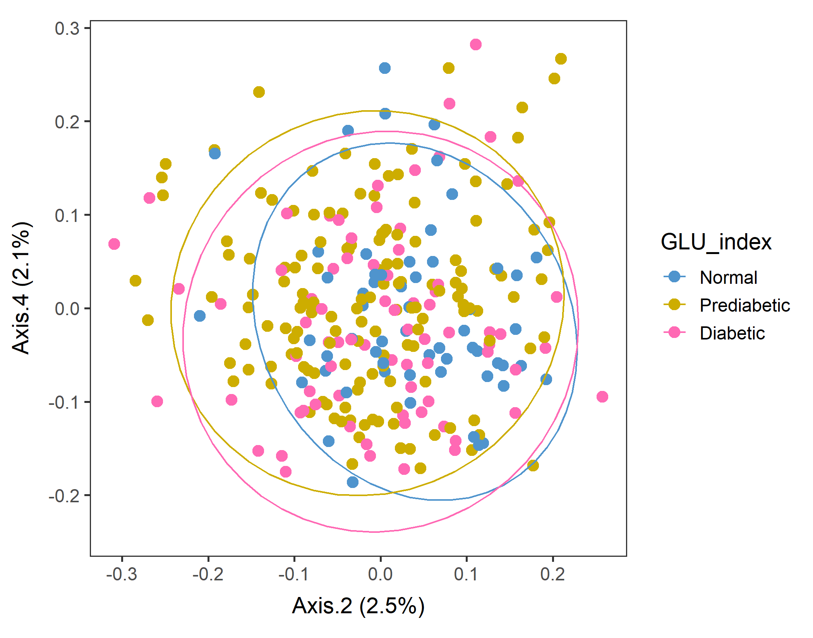
Male in 60plus Lv3 UNweighted
After sorting food by SEQN
vegan::permutest: p-value ~0.86. Assumption OK.
vegan::adonis: p-value:0.007. Groups are different.
Run pairwise adonis (with correct the sample order!). Prediabetic vs Normal are different (p=0.006) but other pairs are not.

Slide 21
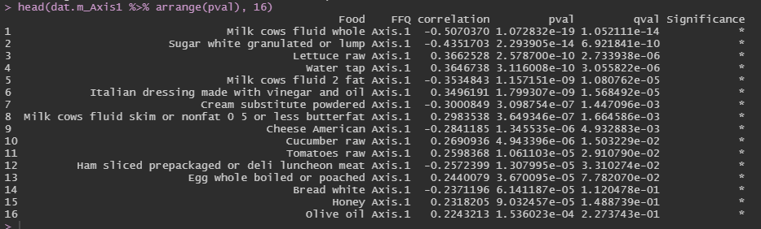
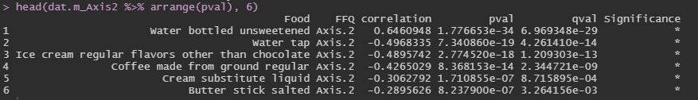
Corr between food groups and Axes: Axes 1 and 2
After sorting food by SEQN, males60plus, Lv3, UNweighted unifrac distance PCoA.
Axis 1 (+) Lettuce, Water, Italian dressing skim milk, Cucumber, Tomatoes, Whole egg, Honey, Olive oil … healthier foods
Axis 1 (–) Whole milk, Sugar, 2% milk, Cream sub, Cheese, Ham, Bread … less healthy foods
Axis 2 (+) Bottoled water
Axis 2 (–) Tap water, Ice cream, Coffee, Cream sub, Butter stick salted
Unweighted distance, so the amounts should not matter, but water is the most correlated variable with the Axes. (?)

Slide 22
Corr between food groups and Axes. (heatmap) Axes 1 and 2
Axis 2 (+) … Bottled water
Axis 2 (–) … Tap water, Ice cream, Coffee, Cream sub, Butter stick salted
Axis 1 (+) … Lettuce, Water, Italian dressing skim milk, Cucumber, Tomatoes, Whole egg, Honey, Olive oil
Axis 1 (–) … Whole milk, Sugar, 2% milk, Cream sub, Cheese, Ham, Bread

Slide 23
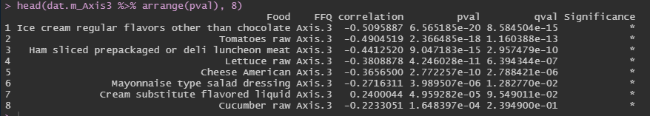
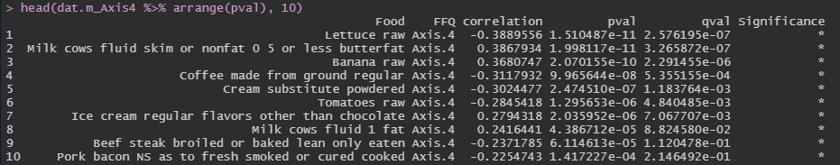
Corr between food groups and Axes: Axes 3 and 4
After sorting food by SEQN, males60plus, Lv3, UNweighted unifrac distance PCoA.
Axis 3 (+) Cream sub
Axis 3 (–) Ice cream, Tomatoes, Ham, Lettuce, Cheese, Mayonnaise-type dressing, Cucumber
Axis 4 (+) Skim milk, Banana, Ice cream, 1%fat milk
Axis 4 (–) Lettuce, Coffee, Cream sub, Tomatoes, Beef steak, Pork bacon

Slide 24
Corr between food groups and Axes. (heatmap) Axes 2 and 3
Axis 3 (+) … Cream sub
Those with lower Axis 2 and lower Axis 3 may have high food intake?
Axis 3 (–) Ice cream, Tomatoes, Ham, Lettuce, Cheese, Mayonnaise-type dressing, Cucumber
Axis 2 (–) … Tap water, Ice cream, Coffee, Cream sub, Butter stick salted
Axis 2 (+) … Bottled water

Slide 25
Corr between food groups and Axes. (heatmap) Axes 2 and 4
Axis 4 (+) … Skim milk, Banana, Ice cream, 1%fat milk
Axis 4 (–) Lettuce, Coffee, Cream sub, Tomatoes, Beef steak, Pork bacon
Axis 2 (–) … Tap water, Ice cream, Coffee, Cream sub, Butter stick salted
Axis 2 (+) … Bottled water

